Slide 1


Advancing Improvements in MCH Outcomes
Using Local Area Estimates from the
National Survey of Children's Health
An Overview of Methods and Field Applications
Presented by:
Christina Bethell, PhD, MBA, MPH
Co-authors: Narangerel Gombojav, MD, PhD, Rosa Avila, MSPH, Kathleen Powers, MSc,
Darika Batbayar, BS, Miriam Million, BS
The Child and Adolescent Health Measurement Initiative
Department of Population, Family and Reproductive Health
Johns Hopkins Bloomberg School of Public Health

Slide 2

The presenter and authors
have no financial relationships or conflicts of interest to disclose.

Slide 3
Overview
Rationale and motivation for constructing local area estimates using the NSCH
Summary of CAHMI’s Local Area Estimation Project
What we’ve accomplished so far
Methodology and Key Issues
Limitations and next steps

Slide 4
Why is Data Useful?
Build Will: Data establishes your position
  A case still has to be made to focus on health improvement using neurosciences
  Data provides a basis for dialogue and creating shared vision and goals
Focus: Data describes current state, gaps needed in the selection of program, policy and services improvement priorities
Learning: Data shows you where and for whom outcomes vary (or programs work or not) and what models or factors influence better or worse performance and outcomes (off diagonal cases)
Data is central to learning, building common vision and trust
Data forces to the surface shared and differing perspectives, definitions and goals

Slide 5
Our Study Question
Can data from the National Survey of Children’s Health (NSCH) be combined with local demographic information to produce actionable city and county estimates to inform efforts to improve MCH outcomes and system performance?

Slide 6
Why Use National Survey of Children’s Health?
Breadth of topics covered in the National Survey of Children’s Health (NSCH)
Valid production of city and county-level estimates of NSCH data can provide a rich resource for MCH programmatic and policy decisions.

Slide 7
Why Synthetic Estimation?
Synthetic estimation - first introduced by the National Center for Health Statistics (NCHS) - can help us understand aspects of MCH, community health, and health systems at the city and county level when these measures are only available at the national and state level.

Slide 8
Synthetic Estimates Using the NSCH
Our #1 technical assistance request—”can I get data for my county or city?”
Concept: Adjust state level prevalence estimates (derived from a representative sampling process) for unique demographic (race x income) characteristics of a local area.
Similar in concept to an “indirect adjustment”
Requires integration of NSCH and Census data

Slide 9
Why Look Below the State Level?
Data on the health of U.S. children is readily available at the national and state levels.
Local areas within a state can vary on factors known or suspected to affect health, health care and other topics covered in national surveys.
Local areas face limitations in obtaining generalizable, valid, and actionable MCH data for understanding health status, community based needs assessments, and population health improvement efforts.

Slide 10
Why Look Below the State Level?
An Example
Prevalence of children with a medical home varies by race
Race distribution in Alameda city differs from California as a whole.
Race/ethnicity | % children with a medical home by race in CA* | Race distribution in California* | Race distribution in Alameda, CA**
Latino/Hispanic | 34.1% | 52.3% | 16.9%
White, non-Hispanic | 63.9% | 27.7% | 31.7%
Black, non-Hispanic | 50.6% | 5.2% | 6.6%
Other, non-Hispanic | 46.5% | 14.8% | 44.8%
Total | 44.7% | 100% | 100%
Data sources: *2011/12 NSCH available at childhealthdata.org, **2008-2012 ACS

Slide 11
Do You Always Need to Collect Local Data?
No! National and state data have many uses at the local level.
If demographic distributions between a local area and the state are similar, state and local estimates likely are too.
However, large within-state demographic variation may mean that local areas actually differ markedly from the state as a whole. Limited resources prevent local data collection.

Slide 12
CAHMI’s Local Area Estimation Project
2008-2016
2008-2010: Developed “do it yourself” guidelines for county and city MCH Epidemiology applications and modeled possible methods (CSHCN focus)
2011- CityMatch Workshop, collaboration with MCHB
2012-2013 –Explored options and obtained user feedback. Organized resources to conduct a study and assess options. CityMatch and CDC staff key partners.
2013-2014: Worked with Population Reference Bureau (PRB), CityMatch and the National Center for Health Statistics (NCHS) to develop and test methods to produce local area estimates using NSCH and Census/ACS data.
2014-2016: Produced local data briefs and continuously refined and tested methods in collaboration with the CA Endowment, ACEs Connection, RWJF, CA “Trauma-Informed Schools” effort and the Lucile Packard Foundation for Children’s Health (KidsData.org). Developed relationships and mocked up technical and production and resource requirements options for creating an online query tool, training and assistance resource for local areas.

Slide 13
Estimates in Action: Rapid Cycle Learning Across Over 225 Local Areas
California Endowment and ACEs Connection communities of action (20)
Robert Wood Johnson Foundation’s MARC (Mobilizing Action for Resilient Communities) (13)
PBS/Detroit News largest US Cities report (17)
Alliance for Strong Families and Communities' Neuroscience/Change in Mind Initiative (7)
Baltimore City Health Department
California trauma informed schools efforts
Lucile Packard Foundation KidsData.org (173)
King County, WA Health Department
Ashville, North Carolina and many more

Slide 14
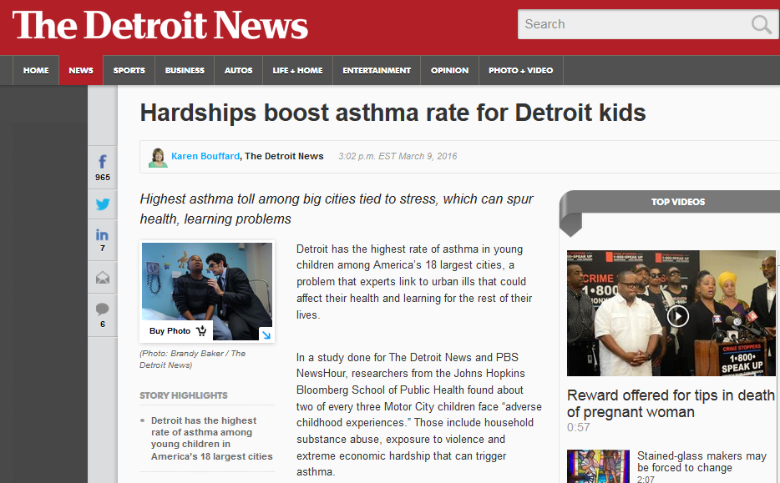

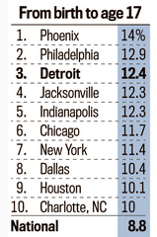
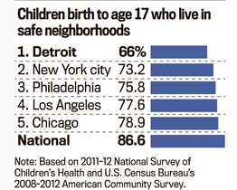
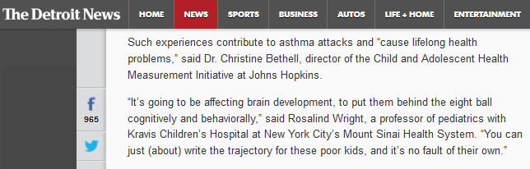
Estimates in Action: PBS/Detroit News Largest Cities

Slide 15
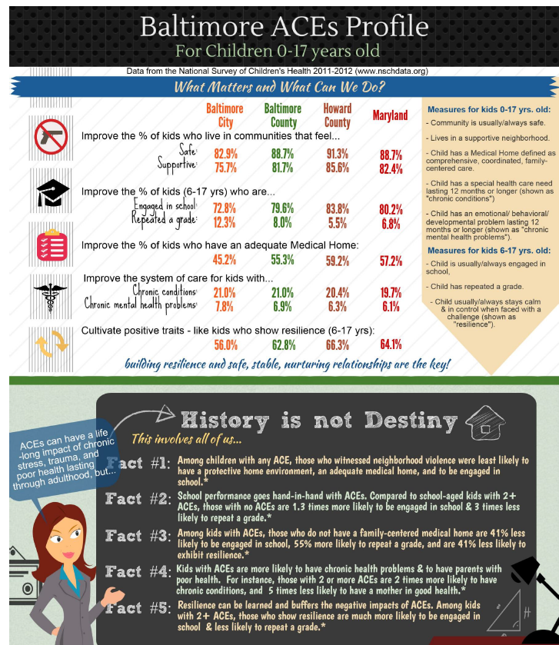
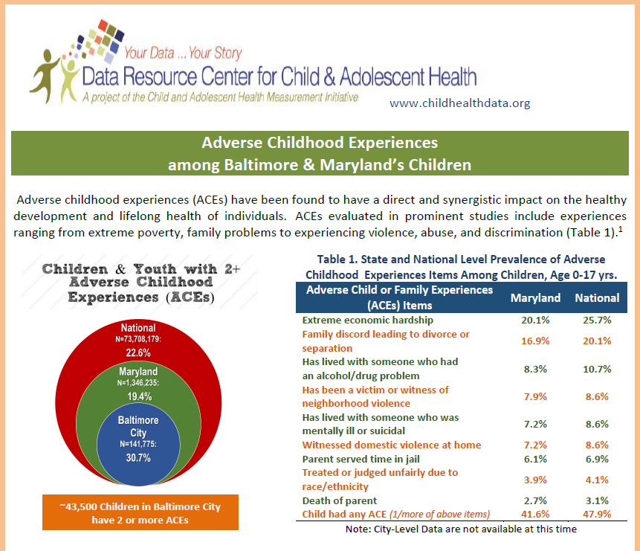
Estimates in Action: ACEs and Resilience Infographics
CAHMI produced approximately 40 infographics for cities and counties, with rapid cycle feedback informing each new round

Slide 16
Percentage of Children Who Had One or More Adverse Childhood Experience, by “Change In Mind” City

Slide 17
Datasets Used to Calculate the Local Area Synthetic Estimates
2011-2012 National Survey of Children’s Health: Provides prevalence rates for child health and well-being indicators
2008-2012 five-year American Community Survey: Provides local population estimates
  The ACS is a nationwide, continuous survey designed to provide reliable and timely demographic, housing, social, and economic data every year
  Samples 3.5 million addresses per year
  Produces reliable estimates for small counties, neighborhoods, and local areas

Slide 18
How Were the Local Area Synthetic Estimates Calculated?
STEP 1: Calculate the prevalence of the indicator for each of 4 race/ethnicity and 4 family income subgroups within the state/region level (NSCH)
Prevalence of “medical home” by race/ethnicity and family income categories in California/Pacific division/West region, 0-17 years. Data source: 2011/12 NSCH
Race/ethnicity | 0-99% FPL, % | 100-199% FPL, % | 200-399% FPL, % | 400% or more FPL, %
Hispanic | 22.8 (n=69) (state) | 33.3 (n=57) (state) | 42.1 (n=44) (state) | 56.2 (n=76) (state)
White non-Hispanic | 57.3 (n=24) (state) | 51.8 (n=43) (state) | 55.1 (n=101) (state) | 72 (n=288) (state)
Black non-Hispanic | 33.3* (n=20) (Census division) | 41.3** (n=47) (Census region) | 55.7* (n=39) (Census division) | 56.0* (n=36) (Census division)
Other non-Hispanic | 27.7* (n=177) (Census division) | 44.1* (n=219) (Census division) | 47.5 (n=32) (state) | 55.5 (n=92) (state)
*Census Division (Pacific) prevalence rate **Census Regional (West) prevalence rate
We are assuming that each cell for this indicator at the state/region level is not significantly different from the same break down we would find at the local level.

Slide 19
How Were the Local Area Synthetic Estimates Calculated?
STEP 2: Determine the number of children in each county/city who fall into each category of the demographic characteristics. (The 2008-2012 ACS population data were also broken down by 4 family income groups and 4 race/ethnicity groups ) To date, focus on areas with > 70K total population.
Number of child population ages 0-17 years by race/ethnicity and family income categories in Alameda city, California. Data source: 2008-2012 ACS
Race/ethnicity | 0-99% FPL | 100-199% FPL | 200-399% FPL | 400% or more FPL | All income groups
Hispanic | 245 | 430 | 765 | 1065 | 2505
White non-Hispanic | 255 | 410 | 900 | 3150 | 4715
Black non-Hispanic | 530 | 305 | 60 | 85 | 980
Other non-Hispanic | 750 | 1195 | 1630 | 3075 | 6650
All race/ethnicity groups | 1780 | 2340 | 3355 | 7375 | 14,850
This distribution is what we assume is different at the local compared to state/region level.

Slide 20
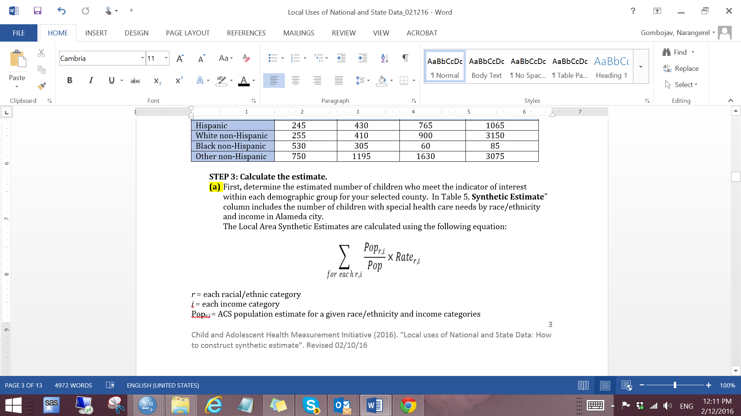
How Were the Local Area Synthetic Estimates Calculated?
STEP 3: Calculate the estimate.
a) Determine the estimated number of children meeting the indicator “focus value” for each race/ethnicity x income subgroup
r = each racial/ethnic category
i = each income category
Pop_{r,i} = ACS population estimate for a given race/ethnicity and income categories
Pop = ACS population estimate
Rate _{r,i} = State/Region prevalence rate from the NSCH by race/ ethnicity and income categories
b) Determine the prevalence of the variable of interest in each county/city by adding up all estimated numbers of children across the 16 subgroups and dividing by total number of children in the city/county
- Divide the total number of children with a medical home in Alameda city by the total number of children living in Alameda city: 7,840/14,850=52.8%

Slide 21
Key Methodology Issue:
Selection of Geographic Area for Prevalence for Each Subgroup
When state prevalence for a subgroup is based on less than 20 sample size, Division, Region or National Level Prevalence for Each Population Subgroup is Used for Calculations
State sample size≥20?
No
Census Division* sample size ≥ 20?
Yes
No
Census Region** sample size ≥20?
State prevalence
Yes
No
National sample size ≥20?
Census Division prevalence
Yes
No
*9 Census Divisions:
East North Central
East South Central
Middle Atlantic
Mountain
New England
Pacific
South Atlantic
West North Central
West South Central*
Census Region prevalence
Yes
National Prevalence
**4 Census Regions:
Northeast
Midwest
South
West
No synthetic estimation

Slide 22
One Test of the Method
(in absence of a “gold standard”
We applied the method used to create synthetic state estimates and compared to actual NSCH state estimates
Steps:
  Generated NSCH prevalence rates by race/ethnicity and income at regional level (Northeast, Midwest, South, and West)
  Generated ACS population distributions by race/ethnicity and income at the state level
  Calculated synthetic prevalence rates at the state level
  Compared the synthetic state prevalence rates anchored to regional prevalence with the published NSCH prevalence rates by state.

Slide 23
Our Findings
Variable: Prevalence of Overweight or Obese Children
All but five states had synthetic state estimates that were within 5 points of actual NSCH estimates
  5+ points higher—Arizona and North Carolina
  5+ point lower—Colorado, Florida, and New Jersey

Slide 25
Key Methodology Issue
Treatment of indicators with very low prevalence and/or small samples for all subgroups
If…
the overall state prevalence rate for the “focus value” for an indicator is less than 10% (e.g. repeated a grade)
OR--all of the “anchor prevalence rates” for each race/ethnicity x income category in a local area required resorting to division, region or national prevalence
… then the synthetic estimate was not calculated based on the “focus value”, but its “opposite”.
Example: We calculated synthetic estimates for “Did not repeat a grade” and then estimated “Repeated a Grade” by subtracting this estimate by 100.

Slide 26
An Example: Parental Aggravation
HealthMeasure | Race Category | Poverty | State | Division | Region | StateRate | StateSampleCount | DivisionRate | DivisionSampleCount | RegionRate | RegionSampleCount | NationRate | NationSampleCount
ParentalStress_CSHCN | Hispanic | 0 to 99 | California | Pacific | West | 0.387359 | 11 | 0.362882 | 17 | 0.3646509 | 66 | 0.3205393 | 190
ParentalStress_CSHCN | Hispanic | 100 to 199 | California | Pacific | West | 0.147204 | 6 | 0.158101 | 16 | 0.1844536 | 44 | 0.254546 | 112
ParentalStress_CSHCN | Hispanic | 200 to 399 | California | Pacific | West | 0.562338 | 5 | 0.515776 | 19 | 0.4625797 | 54 | 0.3491472 | 105
ParentalStress_CSHCN | Hispanic | 400% or higher | California | Pacific | West | 0.330653 | 4 | 0.327692 | 13 | 0.2792052 | 28 | 0.2420617 | 85
ParentalStress_CSHCN | NHWhite | 0 to 99 | California | Pacific | West | 0.131928 | 2 | 0.245107 | 27 | 0.2472311 | 80 | 0.2563488 | 394
ParentalStress_CSHCN | NHWhite | 100 to 199 | California | Pacific | West | 0.073382 | 5 | 0.187126 | 35 | 0.2373394 | 120 | 0.2466147 | 486
ParentalStress_CSHCN | NHWhite | 200 to 399 | California | Pacific | West | 0.357305 | 10 | 0.29879 | 51 | 0.2302491 | 167 | 0.1952945 | 722
ParentalStress_CSHCN | NHWhite | 400% or higher | California | Pacific | West | 0.188495 | 14 | 0.166594 | 53 | 0.1615904 | 155 | 0.1400517 | 693
ParentalStress_CSHCN | NHBlack | 0 to 99 | California | Pacific | West | 0.209197 | 2 | 0.298967 | 7 | 0.2648856 | 12 | 0.3032327 | 211
ParentalStress_CSHCN | NHBlack | 100 to 199 | California | Pacific | West | 0.129121 | 1 | 0.199153 | 3 | 0.1581528 | 8 | 0.2610685 | 112
ParentalStress_CSHCN | NHBlack | 200 to 399 | California | Pacific | West | 0.327522 | 1 | 0.364243 | 2 | 0.3491019 | 5 | 0.2254082 | 85
ParentalStress_CSHCN | NHBlack | 400% or higher | California | Pacific | West |  |  | 0.01316 | 4 | 0.0226701 | 9 | 0.1524607 | 77
ParentalStress_CSHCN | NHOther | 0 to 99 | California | Pacific | West | 0.20549 | 4 | 0.286056 | 26 | 0.3314469 | 41 | 0.3167788 | 114
ParentalStress_CSHCN | NHOther | 100 to 199 | California | Pacific | West | 0.537402 | 1 | 0.262366 | 24 | 0.2777632 | 40 | 0.1789504 | 106
ParentalStress_CSHCN | NHOther | 200 to 399 | California | Pacific | West | 0.092312 | 2 | 0.107013 | 21 | 0.1326765 | 39 | 0.2286877 | 106
ParentalStress_CSHCN | NHOther | 400% or higher | California | Pacific | West | 0.101634 | 1 | 0.14132 | 27 | 0.1543232 | 41 | 0.1646522 | 105
Yes, parents usually/always feel aggravated with child/
parenting
HealthMeasure | Race Category | Poverty | State | Division | Region | StateRate | StateSampleCount | DivisionRate | DivisionSampleCount | RegionRate | RegionSampleCount | NationRate | NationSampleCount
NoParentalStress_CSHCN | Hispanic | 0 to 99 | California | Pacific | West | 61.30% | 21 | 63.70% | 51 | 63.50% | 164 | 67.90% | 438
NoParentalStress_CSHCN | Hispanic | 100 to 199 | California | Pacific | West | 85.30% | 18 | 84.20% | 44 | 81.60% | 146 | 74.50% | 356
NoParentalStress_CSHCN | Hispanic | 200 to 399 | California | Pacific | West | 43.80% | 14 | 48.40% | 49 | 53.70% | 146 | 65.10% | 401
NoParentalStress_CSHCN | Hispanic | 400% or higher | California | Pacific | West | 66.90% | 18 | 67.20% | 40 | 72.10% | 137 | 75.80% | 397
NoParentalStress_CSHCN | NHWhite | 0 to 99 | California | Pacific | West | 86.80% | 9 | 75.50% | 80 | 75.30% | 225 | 74.40% | 1250
NoParentalStress_CSHCN | NHWhite | 100 to 199 | California | Pacific | West | 92.70% | 8 | 81.30% | 111 | 76.30% | 392 | 75.30% | 1753
NoParentalStress_CSHCN | NHWhite | 200 to 399 | California | Pacific | West | 64.30% | 18 | 70.10% | 210 | 77.00% | 708 | 80.50% | 3372
NoParentalStress_CSHCN | NHWhite | 400% or higher | California | Pacific | West | 81.20% | 64 | 83.30% | 325 | 83.80% | 843 | 86.00% | 4406
NoParentalStress_CSHCN | NHBlack | 0 to 99 | California | Pacific | West | 79.10% | 5 | 70.10% | 8 | 73.50% | 22 | 69.70% | 477
NoParentalStress_CSHCN | NHBlack | 100 to 199 | California | Pacific | West | 87.10% | 4 | 80.10% | 6 | 84.20% | 20 | 73.90% | 357
NoParentalStress_CSHCN | NHBlack | 200 to 399 | California | Pacific | West | 67.20% | 2 | 63.60% | 7 | 65.10% | 22 | 77.50% | 415
NoParentalStress_CSHCN | NHBlack | 400% or higher | California | Pacific | West | 100.00% | 8 | 98.70% | 10 | 97.70% | 20 | 84.80% | 347
NoParentalStress_CSHCN | NHOther | 0 to 99 | California | Pacific | West | 79.50% | 5 | 71.40% | 42 | 66.90% | 92 | 68.30% | 301
NoParentalStress_CSHCN | NHOther | 100 to 199 | California | Pacific | West | 46.30% | 2 | 73.80% | 71 | 72.20% | 116 | 82.10% | 355
NoParentalStress_CSHCN | NHOther | 200 to 399 | California | Pacific | West | 90.80% | 8 | 89.30% | 90 | 86.70% | 151 | 77.10% | 407
NoParentalStress_CSHCN | NHOther | 400% or higher | California | Pacific | West | 89.80% | 15 | 85.90% | 104 | 84.60% | 153 | 83.50% | 551
No, parents do NOT usually/
always feel aggravated with child/
parenting

Slide 27
Our Test Findings
Compared “focus value” findings using regular versus “reverse coding” option
Location | No Parental stress | Yes, parental stress | Calculated parental stress (100- No parental stress) | Difference
United States | 77.4 | 22.6 | 22.6 | 0.0
California | 72.2 | 27.8 | 27.8 | 0.0
Alameda city | 78.1 | 21.3 | 21.9 | -0.7
Alhambra city | 73.9 | 25.0 | 26.1 | -1.1
Anaheim city | 70.0 | 28.6 | 30.0 | -1.3
Antioch city | 73.6 | 26.0 | 26.4 | -0.4
Arden-Arcade CDP | 75.1 | 24.6 | 24.9 | -0.4
Bakersfield city | 71.1 | 28.0 | 28.9 | -1.0
Baldwin Park city | 67.7 | 30.8 | 32.3 | -1.5
Bellflower city | 70.5 | 28.5 | 29.5 | -1.0
Berkeley city | 76.6 | 22.1 | 23.4 | -1.3
Buena Park city | 72.6 | 26.3 | 27.4 | -1.1
Burbank city | 73.8 | 24.7 | 26.2 | -1.5
Carlsbad city | 76.9 | 21.7 | 23.1 | -1.5
Carson city | 73.6 | 25.8 | 26.4 | -0.6
Chico city | 74.7 | 24.5 | 25.3 | -0.8
Chino city | 70.7 | 27.5 | 29.3 | -1.9
Chino Hills city | 75.0 | 23.3 | 25.0 | -1.8
Chula Vista city | 70.1 | 28.1 | 29.9 | -1.8
Citrus Heights city | 72.7 | 26.3 | 27.3 | -1.1
Clovis city | 73.1 | 25.6 | 26.9 | -1.2
Compton city | 69.2 | 30.0 | 30.8 | -0.7
Concord city | 73.9 | 24.8 | 26.1 | -1.3
Corona city | 71.4 | 27.0 | 28.6 | -1.6
Costa Mesa city | 72.2 | 26.5 | 27.8 | -1.3
Daly City city | 77.4 | 21.8 | 22.6 | -0.8
Downey city | 66.9 | 31.2 | 33.1 | -1.9
East Los Angeles CDP | 67.2 | 31.6 | 32.8 | -1.2
El Cajon city | 72.6 | 26.7 | 27.4 | -0.7
Elk Grove city | 75.5 | 23.6 | 24.5 | -0.9
El Monte city | 69.6 | 29.5 | 30.4 | -0.9
Escondido city | 71.9 | 27.3 | 28.1 | -0.9
Fairfield city | 74.4 | 24.8 | 25.6 | -0.8
Folsom city | 78.1 | 20.5 | 21.9 | -1.4
Fontana city | 69.2 | 29.5 | 30.8 | -1.3
Fremont city | 79.7 | 19.6 | 20.3 | -0.7
Fresno city | 70.9 | 28.4 | 29.1 | -0.7
Fullerton city | 73.2 | 25.6 | 26.8 | -1.2
Garden Grove city | 73.1 | 25.9 | 26.9 | -1.0
Glendale city | 76.0 | 23.1 | 24.0 | -0.9
Hawthorne city | 71.8 | 27.8 | 28.2 | -0.5
Hayward city | 71.8 | 27.2 | 28.2 | -1.0
Hemet city | 71.9 | 27.7 | 28.1 | -0.4
Hesperia city | 69.6 | 29.4 | 30.4 | -1.0
Huntington Beach city | 75.1 | 23.3 | 24.9 | -1.6
Indio city | 67.2 | 31.1 | 32.8 | -1.7
Inglewood city | 71.9 | 28.2 | 28.1 | 0.1
Irvine city | 79.7 | 19.4 | 20.3 | -0.9
Jurupa Valley | 68.0 | 30.6 | 32.0 | -1.4
Lake Forest city | 75.4 | 23.1 | 24.6 | -1.5
Lakewood city | 73.3 | 25.3 | 26.7 | -1.4
Lancaster city | 71.4 | 28.0 | 28.6 | -0.6
Livermore city | 75.7 | 22.9 | 24.3 | -1.4
Long Beach city | 71.8 | 27.4 | 28.2 | -0.8
Los Angeles city | 71.1 | 28.0 | 28.9 | -0.9
Menifee city | 71.8 | 26.9 | 28.2 | -1.3
Merced city | 71.4 | 27.9 | 28.6 | -0.7
Mission Viejo city | 76.6 | 21.9 | 23.4 | -1.5
Modesto city | 71.7 | 27.5 | 28.3 | -0.8
Moreno Valley city | 70.7 | 28.9 | 29.3 | -0.4
Mountain View city | 77.5 | 21.4 | 22.5 | -1.1
More the 2% point differences observed for only 4 of 154 cities and counties in California for “Parental Aggravation”

Slide 28
Summary: Our Findings
Local area NSCH estimates are viable to produce for the majority of NSCH variables.
Restricting to local areas with a population size of 70,000 or more is conservative.
A robust 16-cell race/ethnicity by household income weighting matrix that uses five-year ACS data yielded sufficient sample for most areas and NSCH variables, with further segmentation possible by age subgroups.

Slide 29
Strengths of this Methodology
Provides a standard approach
Easy to use
Easily explained and easy to understand, compared with more complex regression-based methods
Population estimates are also readily available from the U.S. Census Bureau, and can be updated on a regular basis
Local estimates tend to be closely aligned with the state-level estimates on which they are based

Slide 30
Potential Bias in this Methodology
Synthetic estimates subject to all inherent biases in the data upon which is relies (NSCH and ACS)
Remember:
This is about learning, creating a conversation and optimizing “best available” data.
We DO NOT want to adjust for all explanatory variables, rather to create estimates that can spark dialogue and where local areas working together can rely on common methods
If research is the goal, it is best to use the Research Data Centers at CDC or Census Bureau to access the data for local areas of interest

Slide 31
Potential Bias in this Methodology
There are timing differences between when state and local data were collected: state-level data collection for the NSCH (2011-12) and ACS (2008-12) slightly varied.
The number of stratifying groups are limited by state sample size
Cannot construct confidence intervals or statistical tests

Slide 32
Conclusions
Although locally collected data are ideal, NSCH synthetic estimates provide valuable, standardized data for county and city health departments, local community organizations, and others.
Multiple analysis pathways are needed to construct local estimates to optimize available NSCH sample data.
Not all NSCH variables are suitable for local estimation.
Despite limitations in core assumptions underlying synthetic estimation, use of standardized methods enable cross-area and cross-population comparisons, making use of such estimation methods valuable for program planning and improvement purposes.

Slide 33
Public Health Implications
Many MCH efforts can benefit from local data, but lack resources or capacity to collect data or conduct data analysis.
There is recognized benefit to comparable, standardized data across larger areas.
Performing local area estimation using the NSCH provides local health departments, community and other organizations with the ability to tailor interventions to their community’s specific needs in a way that can easily be compared to other areas in order to observe disparities.
These data have been instrumental in supporting communities’ development of plans to address important MCH issues.

Slide 34


Thank you! cbethell@jhu.edu info@cahmi.org
Get Involved in Further Exploring Local Area Data Methods

